Slide 1


CSCE 5610
Computer Systems Architecture
Course Introduction
Reading: Syllabus

Slide 2
Instructor Information
Dr. Beilei Jiang
Email: beilei.jiang@unt.edu
Office: NTDP E245J
Office Hour: Tuesday and Thursday, 4:00PM-5:00PM, or by appointment

Slide 3
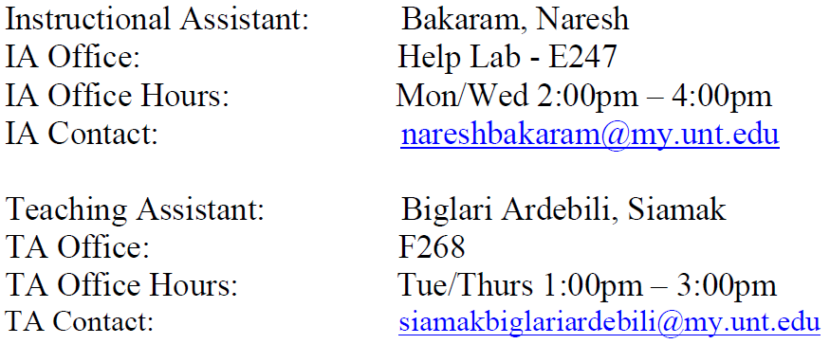
Course Webpage and Schedule
Course webpage can be found at: CANVAS
The lecture schedule is: Tue/Thr, 11:30am-12:50pm, NTDP D201
TA/IA:

Slide 4
Textbooks
1. Computer Organizations and Design, Patterson and Hennessy, 3rd Ed
2. Computer Architecture: A Quantitative Approach, 6th Edition, Hennessy and Patterson, 2017 (or the 5th edition, 2012)

Slide 5
Communication Expectations
Should you have any questions about the course or material in general, you may attend your instructor’s office hours or use your UNT e-mail address to e-mail your instructor directly at the e-mail address listed above with CSCE 5610.001 in the subject line.
Every attempt will be made to answer e-mails within 24 hours, but if no reply is received within this time frame, please follow up with your instructor again to ensure a response.
For assistance with assignments or questions about grading of a particular assignment, you may also contact the TAs/IAs assigned to this directly via e-mail or during their office hours. This information will be available on Syllabus.

Slide 6
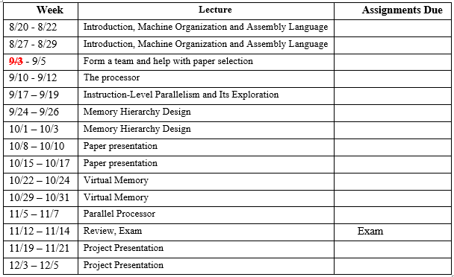
Course Structure

Slide 7
Grading
Assignment 20.0%
Paper presentation 10.0%
Project 30.0%
Exam 40.0%
Total 100.0%

Slide 8
Grading Scale
Tentative grading scale
A >=90%
B >=80% and <90%
C >=70% and <80%
D >=60% and <70%
F <60%
No absolute grading scale; appropriate letter grade cutoffs set by instructor at the end of semester.

Slide 9
Late Policy
All assignments, shall be turned in electronically using Canvas.
Students are responsible for submitting the correct assignments (i.e., uploading the proper files) for each applicable assignment submission on Canvas. Please double-check the file you uploaded on Canvas.
No late work will be accepted for quizzes or exams. Homework, however, will be accepted up to 24 hours late and be assessed a 50% grade reduction penalty. Project submitted more than 24 hours late will not be accepted and receive a grade of 0.
All holidays and weekends will be counted as calendar days

Slide 10
Exams
Exam (40%)
During class
Exam: There will be a comprehensive exam during the scheduled exam time. All students are expected to take the exams during the scheduled time period.
Missed exams will be granted zero points. Illness and severe circumstances may be accommodated only with solid evidence. Email Dean of students before exam and provide solid evidence whenever possible.

Slide 11
Attendance
Attendance is mandatory
Students are required to attend and be on time for the class face-to-face. Please note that attendance is mandatory!!! A student who misses class is still responsible to find out what was discussed and to learn the material that was covered and obtain the homework that was assigned on the missed day.
The instructor is not responsible for re-teaching material missed by a student who did not attend class. Therefore, each student is accountable for and will be evaluated on all material covered in this course, regardless of attendance.
If there are extenuating circumstances preventing you from attending the class, please notify your instructor so that you can work together to ensure your success in learning the material.

Slide 12


Attendance-bonus
We will check the attendance about 10 times (at any time during class):
Attendance: 10 times
>=9: +3%
>=5 and < 9: +2%
>=1 and < 5: +1%
0

Slide 13
Paper Presentation
Form a group with up to 3 members
Step 1: Selecting one recently published paper from a top conference, HPCA 2024 or ISCA 2024.
Step 2: Prepare slides for a 15-20 minutes presentation in class. Upload the slides to Canvas by October 4. One per group submit to CANVAS.
Step 3: Present the paper in class using the slides during the assigned presentation time.

Slide 14
Term Project
The process is as follows:
Project Proposal: By October 22. One per group submit to CANVAS.
Project presentation: By November 15. One per group submit to CANVAS.
Final Report: By November 15. One per group submit to CANVAS.

Slide 15
Project
Every student must complete a term project. Teamwork is encouraged. Each team can have at most three students. You are responsible for defining your own project. Your project can be either a survey or an implementation study. The project must have a fairly significant piece of work. Students are encouraged to take on projects that involve experimental efforts or proving new results (or both). Survey papers should be considered an option of last resort --- if you take this option, your survey paper should be fairly extensive. It would also be much preferable to survey research that is more "cutting edge" rather than work from 10 or 20 years ago.
Project areas:
Processor, memory, and storage systems architecture
Parallelism: instruction, thread, data, multiprocessor
Datacenter-scale computing
IoT, mobile, and embedded architecture
Interconnection network, router, and network interface architectures
Architectures for emerging applications including machine learning and bioinformatics
Architectural support for programming languages or software development
Architectural support for interfacing with accelerators
Architectural support for security, virtual memory, and virtualization
Dependable processor and system architecture
Architectures for emerging technologies including novel circuits, memory technologies, quantum computing, etc.
Architecture modeling, simulation methodologies, and tools
Evaluation and measurement of real computing systems
...

Slide 16
Project Proposal
Write a short proposal, one or two paragraph (about 1-page single column, not special format requirement) that describes your project, what you aim to accomplish, and the motivation behind your choice of project.
Submission
Submit the proposal (WORD or PDF) by October 22.
One per group submit to CANVAS.
Detailed rubrics will be available on Canvas.

Slide 17
Presentation and Slides
Prepare slides for a 15-20 minutes project presentation in class. Upload the slides to Canvas by November 15. One per group submit to CANVAS.
Detailed rubrics will be available on Canvas.

Slide 18
Project Report
Final Report: at least 4 pages for double columns project report in IEEE format (please use the IEEE template uploaded on Canvas under the Project Module). For survey project, please use the file “Instructions for Writing Good Survey Paper” for reference. (by November 15). [We will check the plagiarism score, please ensure your plagiarism score is not greater than 15% exclude the reference. Please draft the report by yourself instead of using the AI tools, like ChatGPT, to write the report. We will check the AI score, if AI score is greater than 15%, you will get 0 points for the project report.] One per group submit to CANVAS.
PLEASE DO NOT USE ANY AI TOOLS TO DRAFT YOUR REPORT!!!

Slide 19
Academic Integrity
All works submitted for credit must be original works created by the scholar uniquely for the class. It is considered inappropriate and unethical, particularly at the graduate level, to make duplicate submissions of a single work for credit in multiple classes, unless specifically requested by the instructor. Work submitted at the graduate level is expected to demonstrate higher-order thinking skills and be of significantly higher quality than work produced at the undergraduate level.
Academic Integrity is deﬁned in the UNT Policy on Student Standards for Academic Integrity. Any suspected case of Academic Dishonesty will be handled in accordance with the University Policy and procedures. Possible academic penalties range from a verbal or written admonition to a grade of F in the course. Further sanctions may apply to incidents involving major violations. You will ﬁnd the policy and procedures at: http://vpaa.unt.edu/academic-integrity.htm.

Slide 20
Question?

